Slide 1
SOFTWARE SUPPLY CHAIN AMONG IOT DEVICES
with
HYPERLEDGER FABRIC
By
Aryaman Adivya Singh
&
Ayush Poddar

Slide 2
Introduction
IoT and machine learning deliver insights otherwise hidden in data for rapid, automated responses and improved decision making. Machine learning for IoT can be used to project future trends, detect anomalies, and augment intelligence by ingesting image, video and audio.
A consortium of such industries can collaborate and commit themselves to quality via Blockchain. Thus, addressing the two fundamental concerns , i.e., proof and trust.
One such hypothetical business network for distributing the particular machine learning model for an IoT platform. This model of blockchain can be made available on the cloud, o-premises and/or the edge.
Uniquely this architecture provides the following features:-
1. Rapid model deployment to operationalize machine learning quickly
2.Flexibility to use your data science library of choice
3. Safety and Privacy due to Hyperledger

Slide 3
HyperLedger Fabric - A general Introduction
Hyperledger Fabric is an open source enterprise-grade permissioned distributed ledger technology (DLT) platform, designed for use in enterprise contexts, that delivers some key differentiating capabilities over other popular distributed ledger or blockchain platforms.
For enterprise use, we need to consider the following requirements:
Participants must be identified/identifiable.
Networks need to be permissioned.
High transaction throughput performance.
Low latency of transaction confirmation.
Privacy and confidentiality of transactions and data pertaining to business transactions.

Slide 4
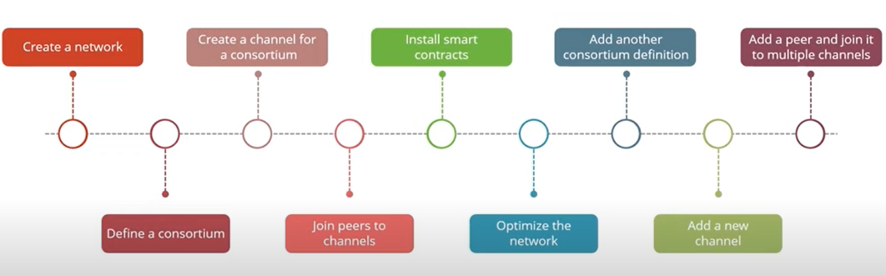
Hyperledger Fabric - Steps to Create a Network

Slide 5
Modular
01
Highly Secure
02
Cryptocurrency-
Agnostic
The Design
Philosophy
Interoperable
04
03
Complete with API’s
05
Employing a module as basis of the design or construction.
It provides great security to processed Transactions
The platform has the ability to support all cryptocurrencies without preference of any particular one.
Is greatly capable of exchanging and making use of operation.
This contract defines how the two communicate with each other using requests and responses.

Slide 6
HyperLedger Fabric Installation Guide

Slide 7
Docker Engine:
Version 17.03or higher
Docker-Composer:
Version 1.8 or higher
npm: v5.x
Operating Systems: Ubuntu Linux 14.04 / 16.04
LTS (both 64-bit), or Mac OS 10.12
git: 2.9.x or higher
Python: 2.7.x
A code Editor:
e.g.VScode

Slide 8
Prerequisites command lines
Ubuntu
curl -O https://hyperledger.github.io/composer/v0.19/prereqs-ubuntu.sh
chmod u+x prereqs-ubuntu.sh
./prereqs-ubuntu.sh
Mac OS
curl -o- https://raw.githubusercontent.com/creationix/nvm/v0.33.0/install.sh | bash
touch .bash_profile
curl -o- https://raw.githubusercontent.com/creationix/nvm/v0.33.0/install.sh | bash
nvm —-version
nvm install --lts
nvm use --lts
node --version

Slide 9
Development Envrionment
Note that you should not use su or sudo for the following npm commands.
Essential CLI tools:
npm install -g composer-cli@0.19
Utility for running a REST Server on your machine to expose your business networks as RESTful APIs:
npm install -g composer-rest-server@0.19
Useful utility for generating application assets:
npm install -g generator-hyperledger-composer@0.19
Yeoman is a tool for generating applications, which utilises generator-hyperledger-composer:
npm install -g yo

Slide 10
Hyperledger Composer - The Formal Definition!
Hyperledger Composer is a set of collaboration tools for building blockchain business networks that make it simple and fast for business owners and developers to create smart contracts and blockchain applications to solve business problems.Built with JavaScript, leveraging modern tools including node.js, npm, CLI and popular editors, Composer offers business centric abstractions as well as sample apps with easy to test devops processes to create robust blockchain solutions that drive alignment across business requirements with technical development.
Define the assets that are exchanged in a blockchain-based use case .
Define the business rules around what transactions are possible.
Define participants, identity and access controls for what roles exist and which roles can execute which types of transactions .

Slide 11
HyperLedger Composer -Installation

Slide 12
HyperLedger Composer Playground- Installation
1. Install Playground
npm install -g composer-playground@0.19
2. Install Hyperledger Fabric
mkdir ~/fabric-dev-servers && cd ~/fabric-dev-servers
curl -O https://raw.githubusercontent.com/hyperledger/composer-tools/master/packages/fabric-dev-servers/fabric-dev-servers.tar.gz
tar -xvf fabric-dev-servers.tar.gz
3.Install Fabric Servers
cd ~/fabric-dev-servers
export FABRIC_VERSION=hlfv11
./downloadFabric.sh

Slide 13
Controlling the Composer
Starting and stopping Hyperledger Fabric
cd ~/fabric-dev-servers
export FABRIC_VERSION=hlfv11
./startFabric.sh
./createPeerAdminCard.sh
To start the web app
composer-playground

Slide 14
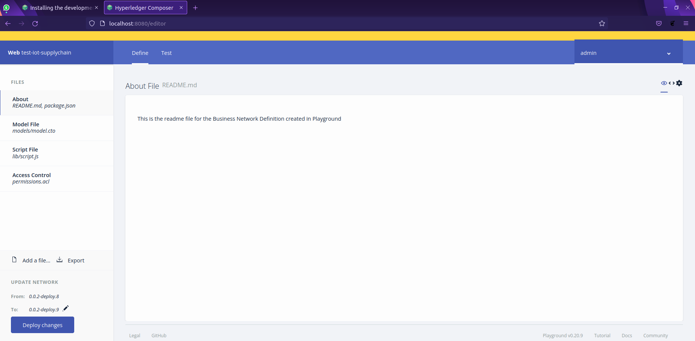
HyperLedger Composer - Beginner’s Guide

Slide 15
HyperLedger Business Card - Architecture
Model File (.cto)
Assets
Participants
Transactions
The composer archive create command is used to create a business network archive file from a business network definition folder on disk
.bna
Chain Code Script (.js)
Permission FIle (.acl)
Transaction Rules
Access Control Rules

Slide 16
Software Supply Chain modelling using Hyperledger Composer

Slide 17
Main Characters(Peers/Orderers)
Data Scientist
ML Engineer
IOT Enterprise
IOT Device List
A Data scientists will have the technical skills to solve complex problems – and the curiosity to explore what problems need to be solved with the data provided by the user.
The Machine learning engineer will work with data and build machine learning models. They will clean and interpret data and build models using a combination of machine learning algorithms and data.
An IoT Enterprise will s form the backbone of the internet as the tech giant will distribute the Trained models from it's server to the suitable IoT device.
An IoT Device will receive the Trained Model according to data it sent, and apply it's updates on it accordingly.

Slide 18
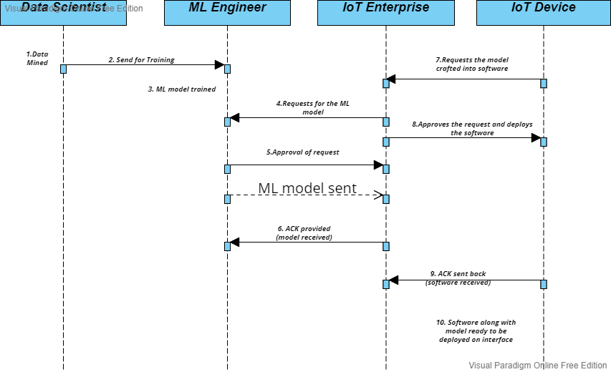
PROJECT SEQUENCE DIAGRAM

Slide 19
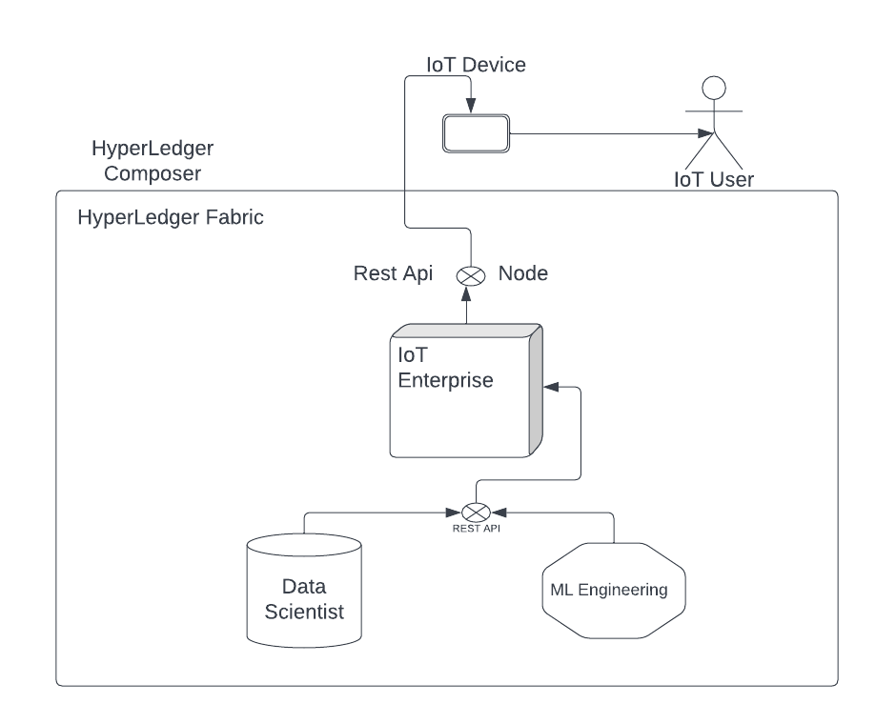
PROJECT ARCHITECTURE DIAGRAM

Slide 20
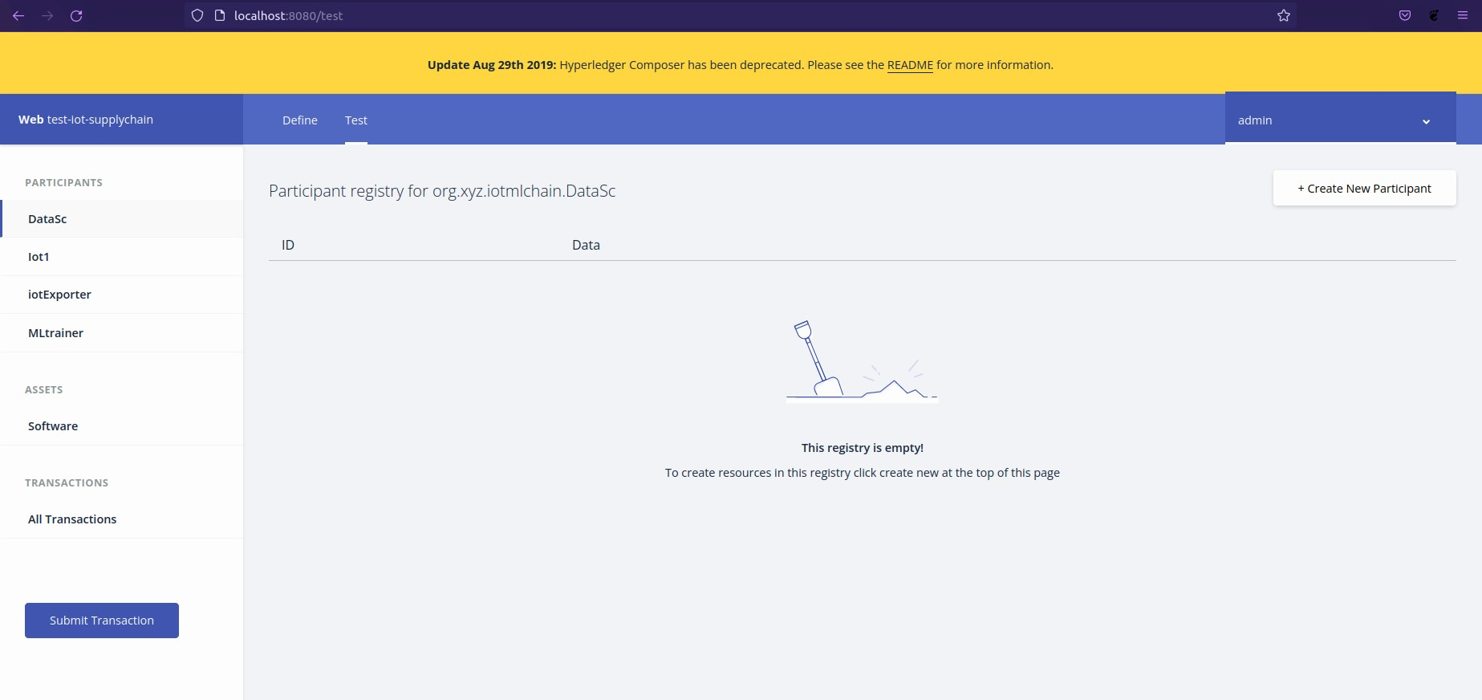
The Testing Ground

Slide 21
PROCEDURE TO CONDUCT TRANSACTIONS

Slide 22
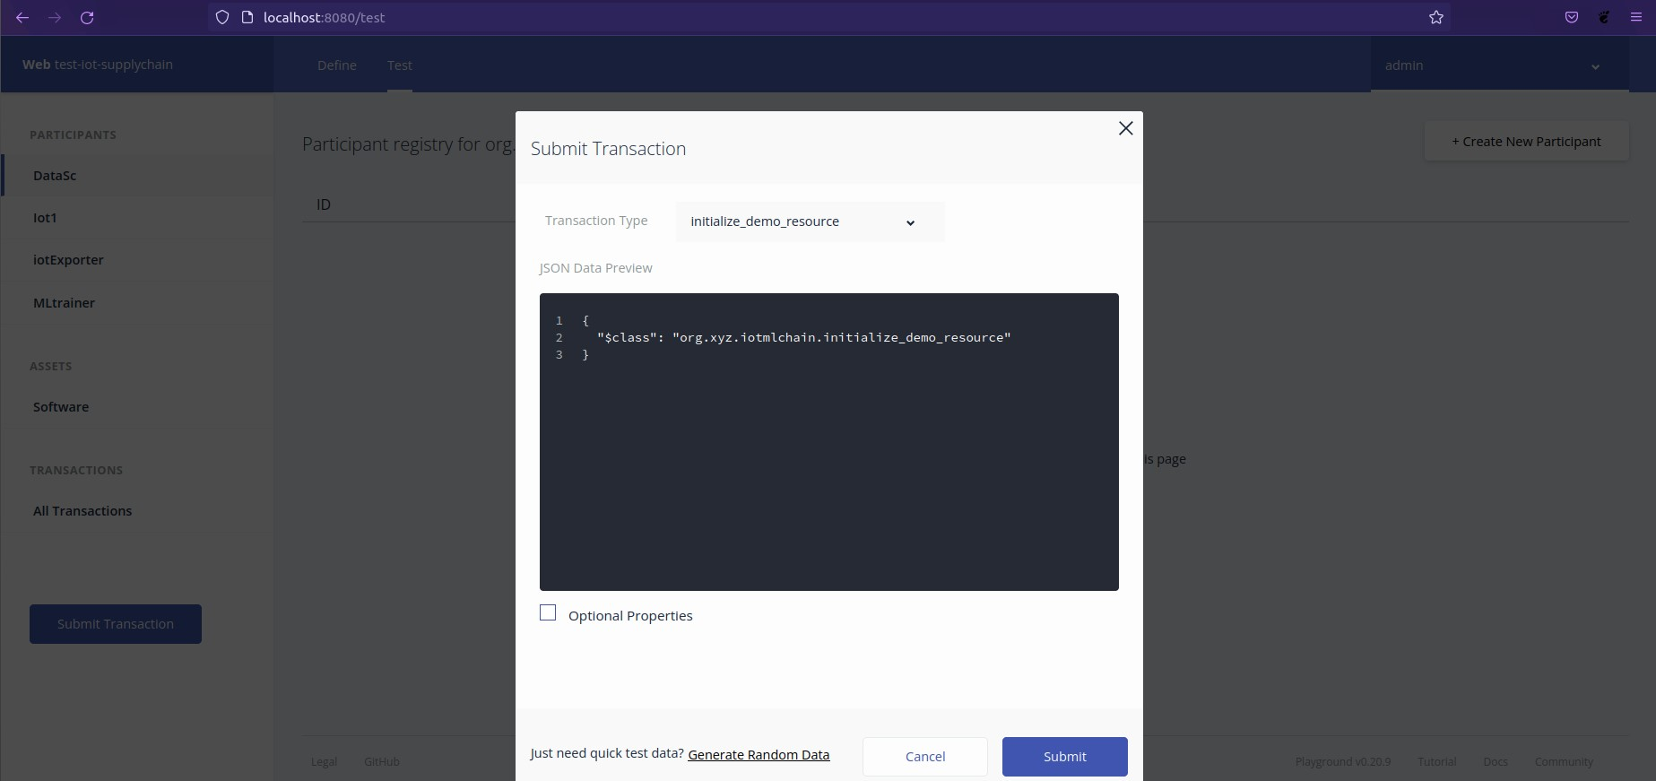
Initializing the Engineering Process

Slide 23
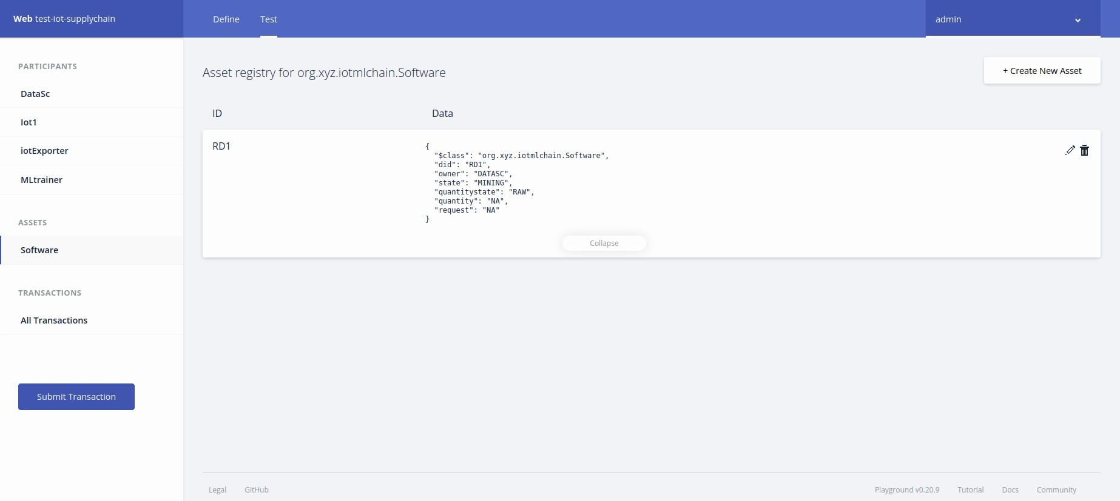
Status of Software after being Initialized

Slide 24
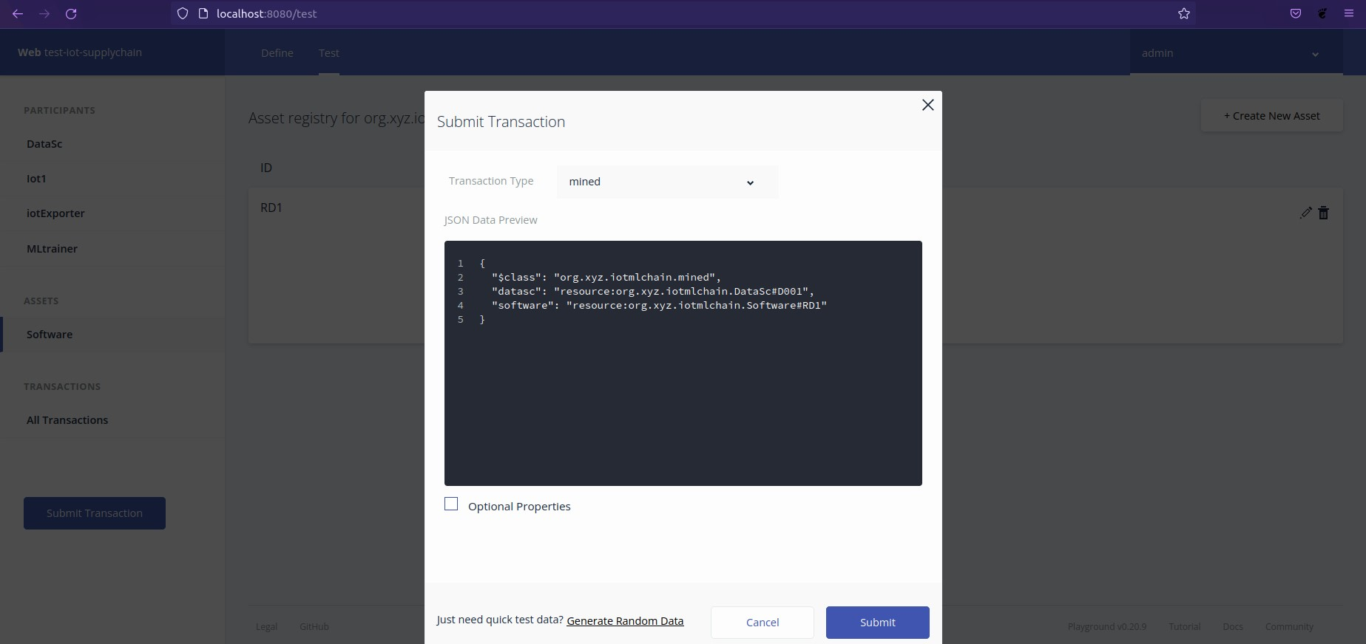
Data Mined and Pattern Generated Transaction

Slide 25
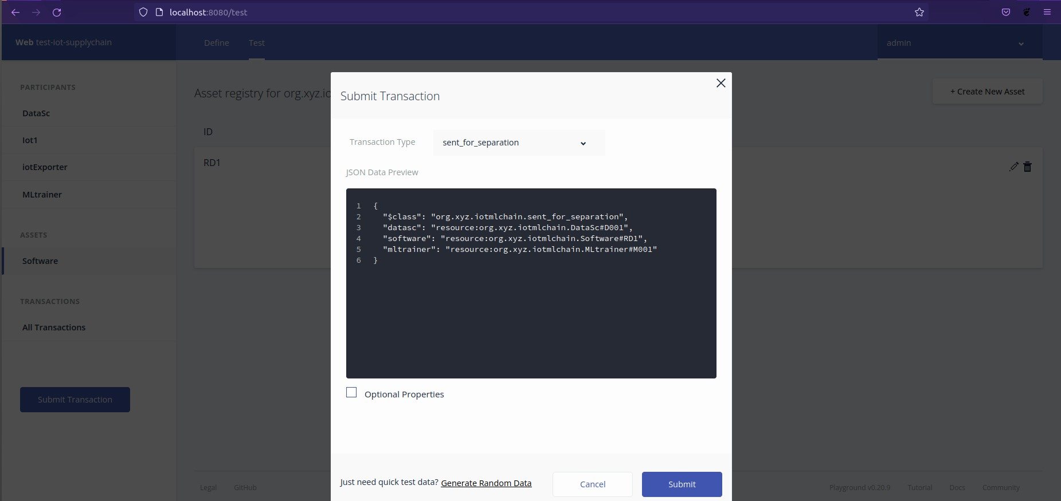
Data Sent for Training and Engineering

Slide 26
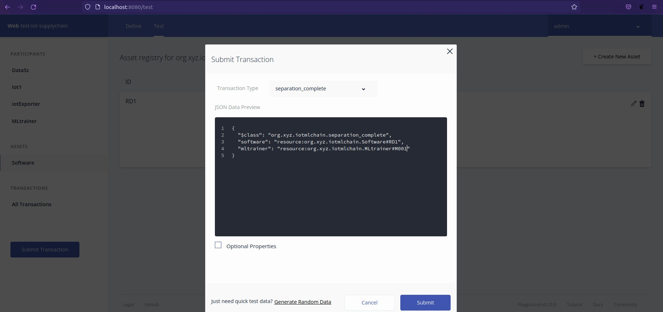
ACK sent after completion of Data Engineering

Slide 27
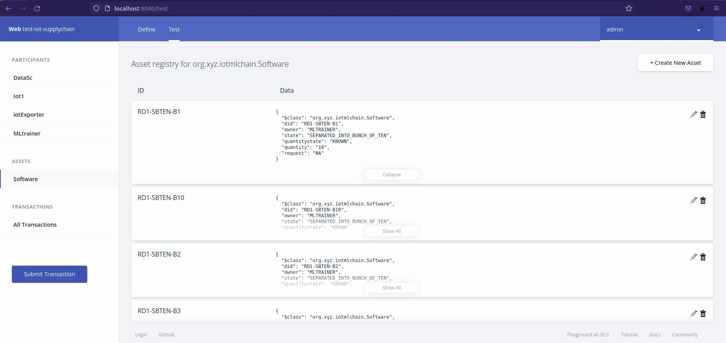
Software Status Screen after Data Separation

Slide 28
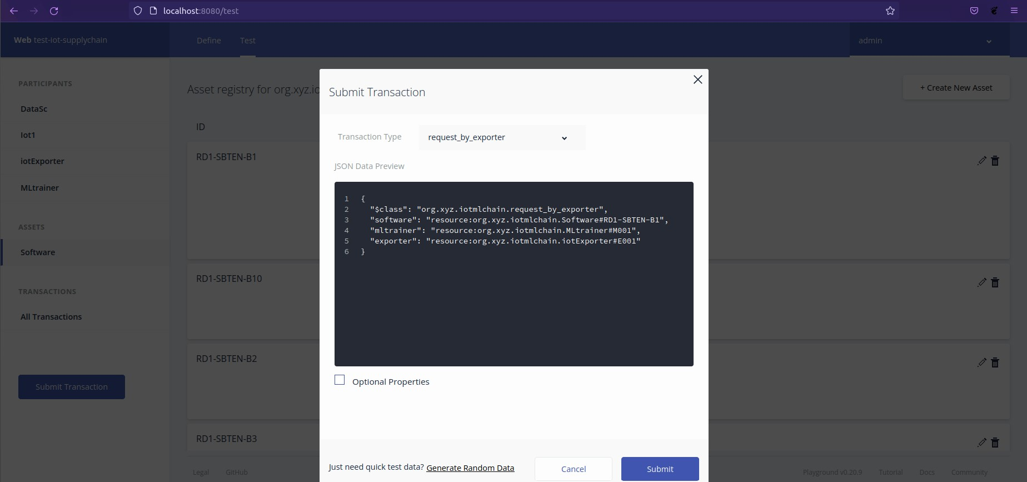
Request by IoT Enterprise for the Software

Slide 29
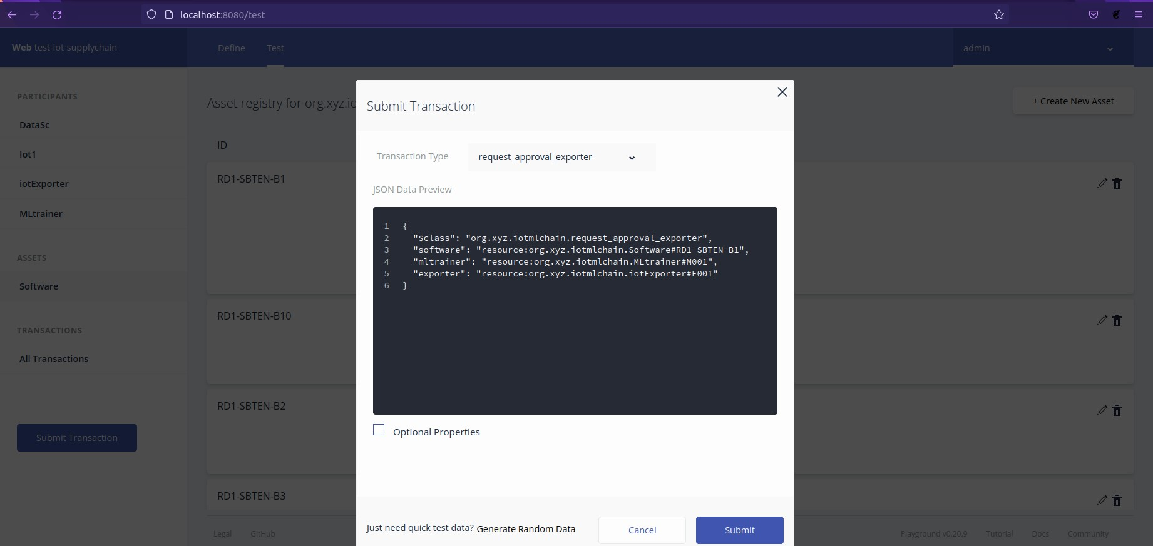
Request Approved for sending software for training

Slide 30
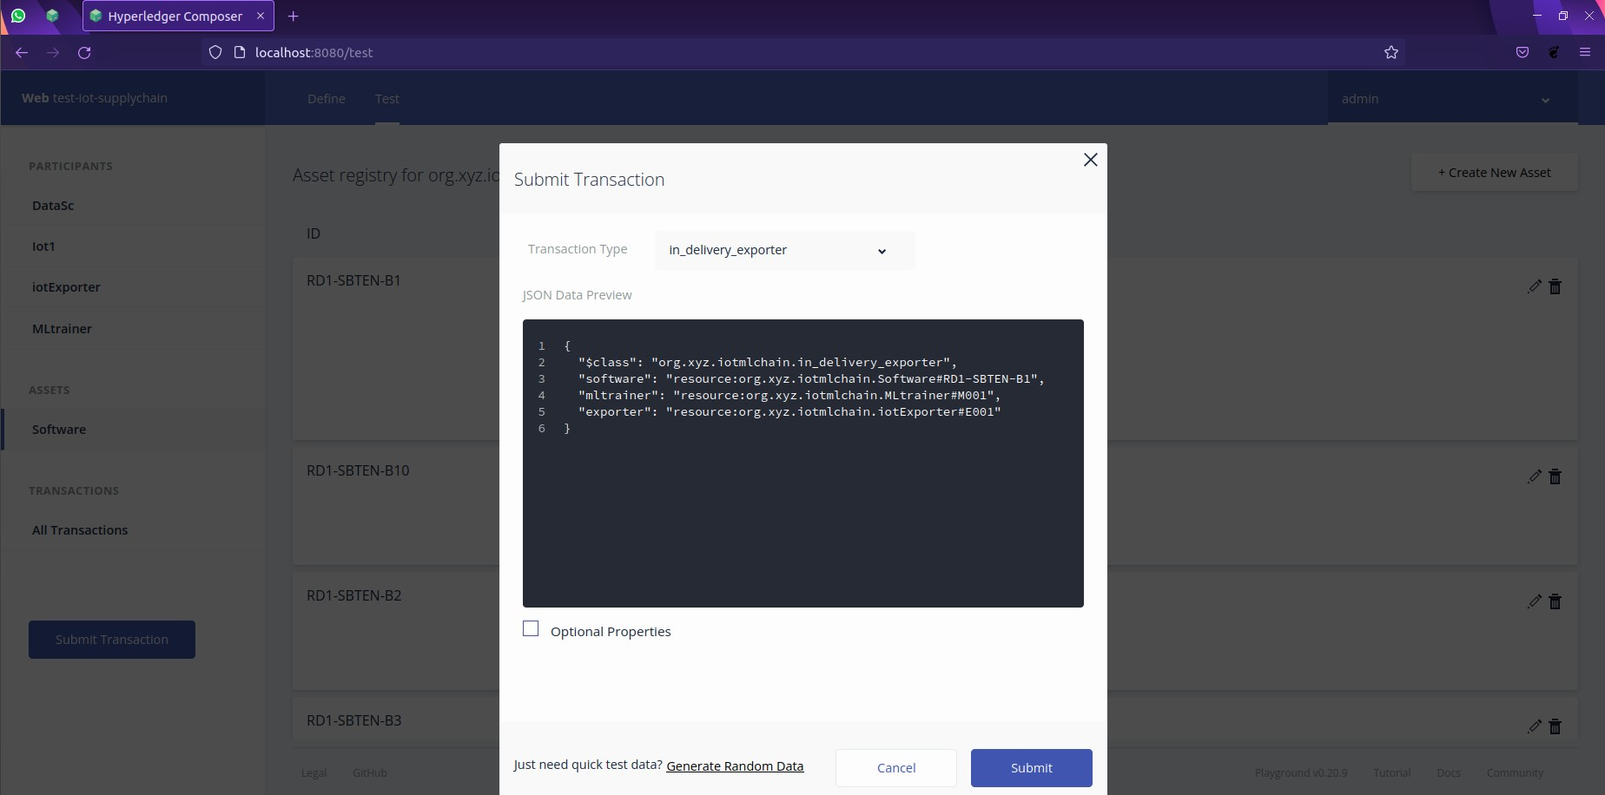
Transaction for Delivery Status
(from ML Engineer to IoT Enterprise)

Slide 31
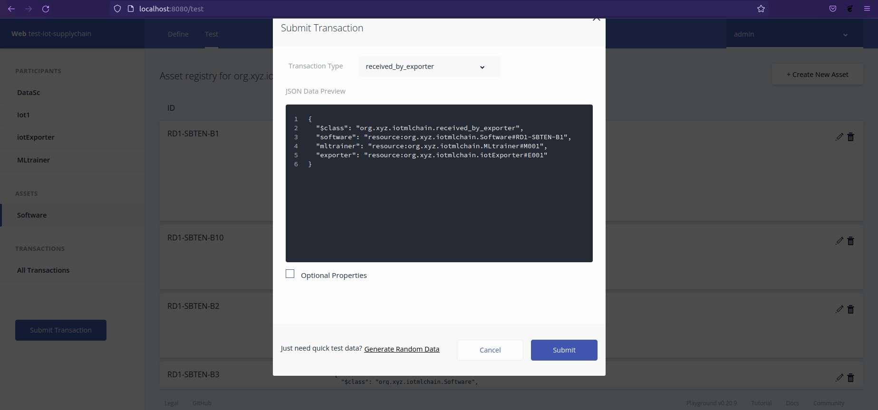
ACK Transaction for successful delivery to IoT Enterprise

Slide 32
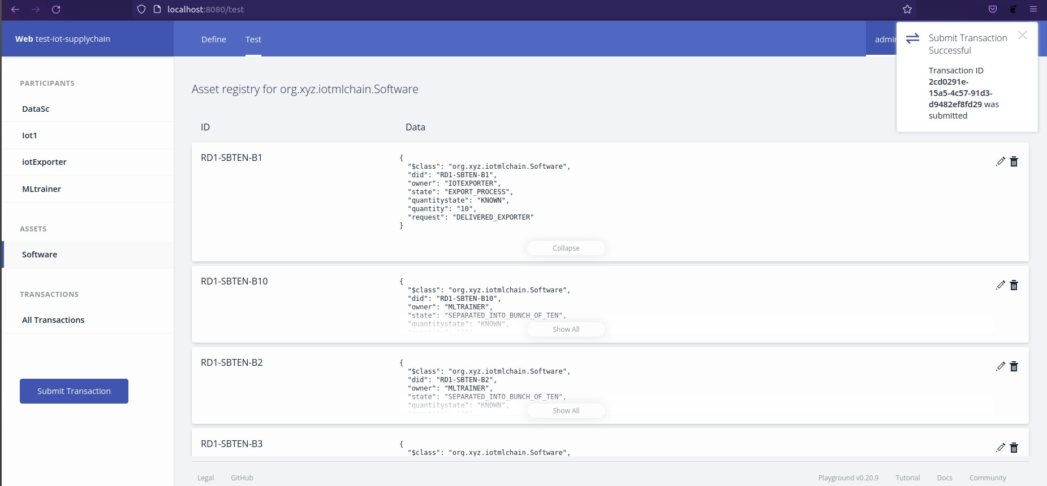
Status screen for software code “RD1-SBTEN-B1”

Slide 33

Request by IoT Device for the Engineered Software

Slide 34
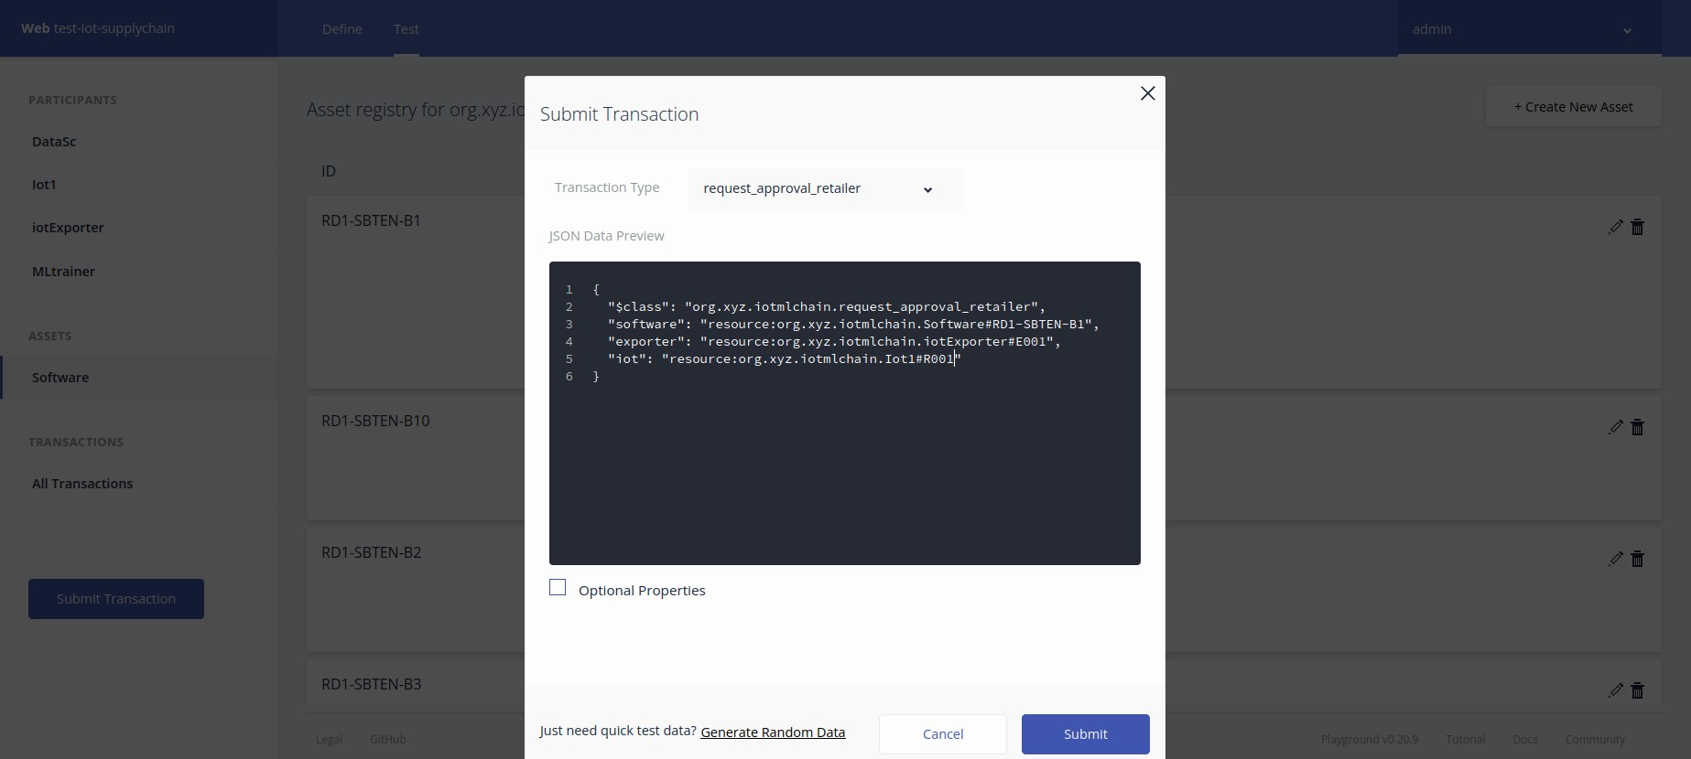
Request Approval by IoT Enterprise for particular Software

Slide 35

Transaction for sending software
(from IoT Enterprise to IoT Device)

Slide 36
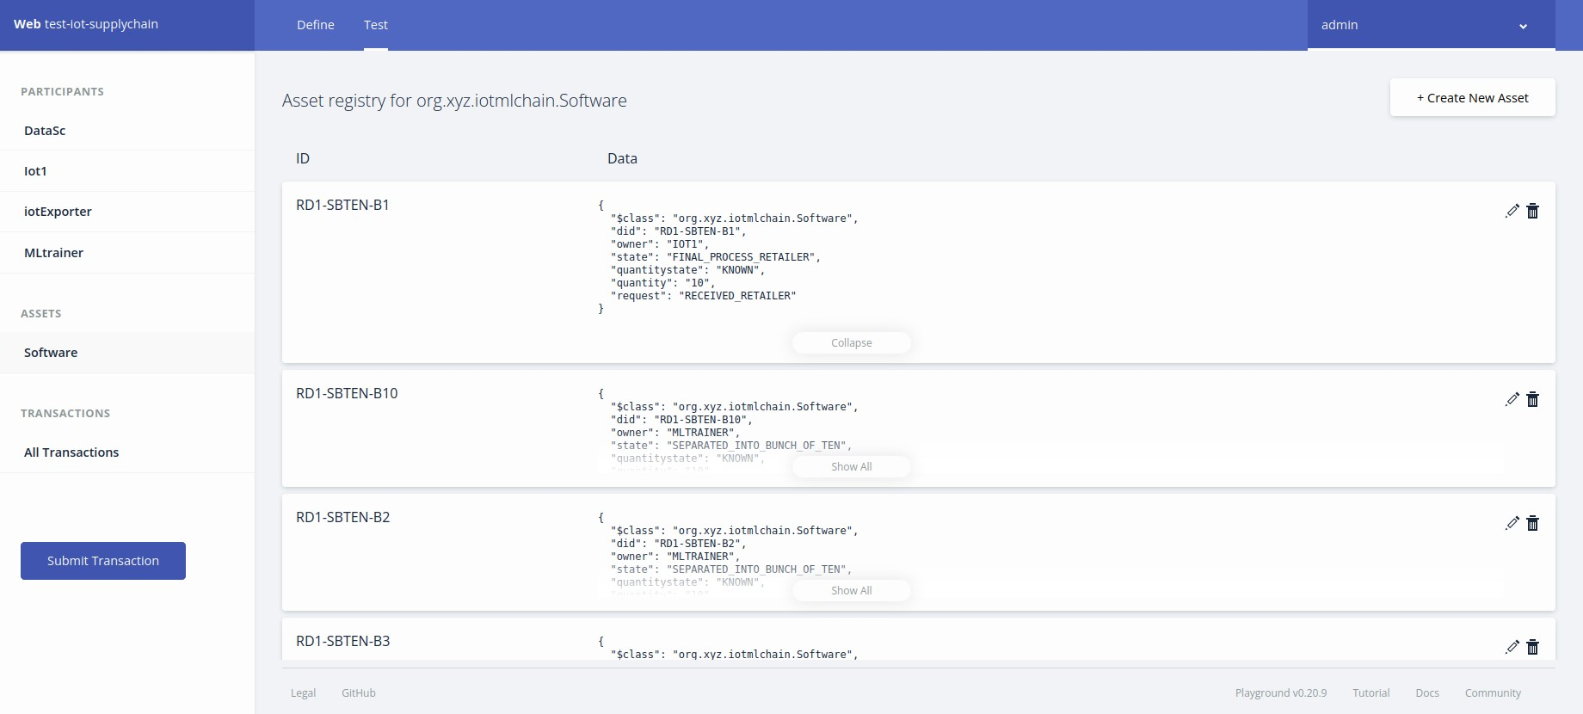
Final status Screen showing successful delivery of software(RD1-SBTEN-B1)

Slide 37
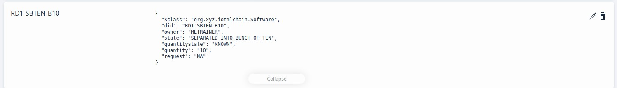
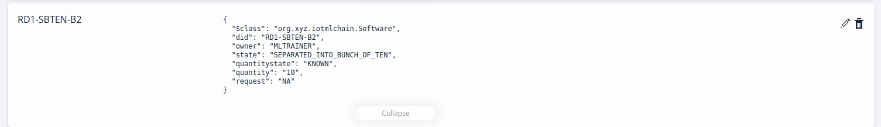
Status of other Software Pieces still waiting for further processes

Slide 38

Software being sent to IoT Device via transmission lines for initiating the required update

Slide 39
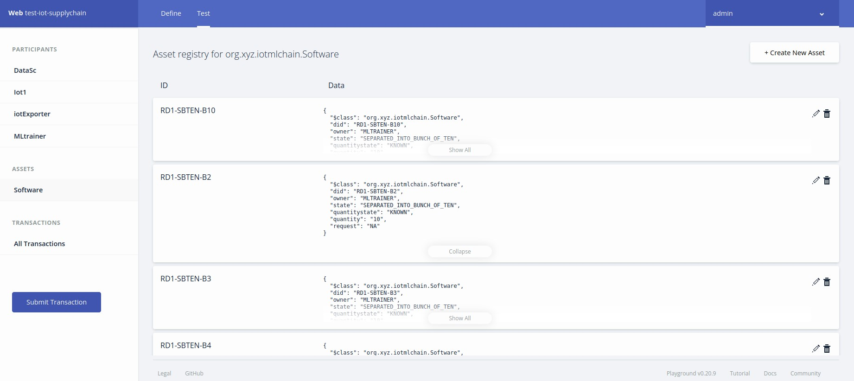
Software “RD1-SBTEN-B1” sent and removed from the pending softwares list

Slide 40
Future Improvements
Make a visual Interface for each of the Orderers for convenient use
Adding multiple Business Environments to communicate and initiate among huge networks
Amplifying Personal Fabric Environment between the Peers
Enabling connection of multiple IoT Devices to join the Fabric

Slide 41
BIBLIOGRAPHY
https://www.softwareag.com/en_corporate/resources/what-is/machine-learning.html#:~:text=IoT%20and%20machine%20learning%20deliver,ingesting%20image%2C%20video%20and%20audio.
https://hyperledger.github.io/composer/v0.19/installing/development-tools
https://medium.com/hackernoon/hyperledger-fabric-installation-guide-74065855eca9
https://hyperledger-fabric.readthedocs.io/en/release-2.2/whatis.html

Slide 42
THANK YOU
MENTOR
DR. SUCHITHRA M.
Email -suchithm@srmist.edu.in
Associate Professor,Department of Computing Technologies
School of Computing
College of Engineering and Technology
SRM Institute of Science and Technology
Kattankulathur – 603203, India.
TEAM LEADER
ARYAMAN ADIVYA SINGH
Email - aryamanadivyasingh@gmail.com
Linkedin - https://bit.ly/Aryaman147
B.Tech 2024, Department of Computing
SRM Institute of Science and Technology
Kattankulathur – 603203, India.
AYUSH PODDAR
Email-ayushpoddar1210@gmail.com
B.tech 2024, Department of Computing
SRM Institute of Science and Technology
Kattankulathur - 603203, India.
Project Download
https://bit.ly/HLAryaman

